Slide 1
Simple Image Detection & Segmentation using Mask RCNN
Machine Learning Mastery Tutorial
adapted and annotated by Kayla Neal for Pearce Lab

Slide 2
Imports
Tensorflow is used as a backend for keras
import tensorflow as tf
from tensorflow.keras.preprocessing.image import load_img, img_to_array
The Mask RCNN model can be downloaded from github – not tf2 compatible, an edited version is.
from Mask_RCNN.mrcnn.config import Config
from mrcnn import visualize
from mrcnn.model import MaskRCNN
matplot is also used
from matplot import pyplot
from matplot.patches import Rectangle

Slide 3
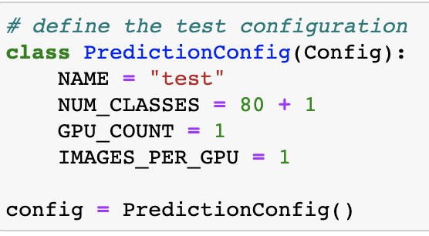
Define Configuration
Modify the existing configuration given in config.py of the mrcnn repository
NUM_CLASSES is defined to be the 80 classes the pretrained coco dataset is trained on PLUS the background
NAME has to be defined
create an instance of the new configuration here to use in the compilation later

Slide 4
Bounding Boxes
def draw_image_with_boxes(filename, boxes_list):
data = pyplot.imread(filename)
pyplot.imshow(data)
ax = pyplot.gca()
for box in boxes_list:
y1, x1, y2, x2 = box
width, height = x2-x1, y2-y1
rect = Rectangle((x1,y1), width, height, fill=False, color=’red’)
ax.add_patch(rect)
pyplot.show()
The mrcnn model defines a display_instances() function that is used to view the classification, bounding box, and segmentation
Make a function that just displays the bounding box:

Slide 5
Compile Model and Load Weights
rcnn = MaskRCNN(mode = ‘inference’, model_dir = ‘./’, config = config)
‘inference’ for testing, ‘training’ for training
rcnn.load_weights(‘mask_rcnn_coco.h5’, by_name = True)
The coco dataset is available in the mrcnn repository
Contains the weights trained with this data

Slide 6
Class Names for Classification
Since the coco dataset is being used, a class_names array is created based on the categories coco was trained on and the background:
class_names = ['BG', 'person', 'bicycle', 'car', 'motorcycle', 'airplane', 'bus', 'train', 'truck', 'boat', 'traffic light', 'fire hydrant', 'stop sign', 'parking meter', 'bench', 'bird', 'cat', 'dog', 'horse', 'sheep', 'cow', 'elephant', 'bear', 'zebra', 'giraffe', 'backpack', 'umbrella', 'handbag', 'tie', 'suitcase', 'frisbee', 'skis', 'snowboard', 'sports ball', 'kite', 'baseball bat', 'baseball glove', 'skateboard', 'surfboard', 'tennis racket', 'bottle', 'wine glass', 'cup', 'fork', 'knife', 'spoon', 'bowl', 'banana', 'apple', 'sandwich', 'orange', 'broccoli', 'carrot', 'hot dog', 'pizza', 'donut', 'cake', 'chair', 'couch', 'potted plant', 'bed', 'dining table', 'toilet', 'tv', 'laptop', 'mouse', 'remote', 'keyboard', 'cell phone', 'microwave', 'oven', 'toaster', 'sink', 'refrigerator', 'book', 'clock', 'vase', 'scissors', 'teddy bear', 'hair drier', 'toothbrush']

Slide 7
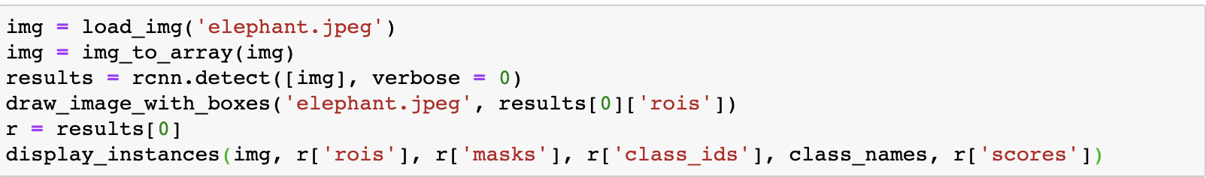
Predictions
draw_image_with_boxes will display ONLY the bounding box overlaid on the image
display_instances is from mrcnn.visualize
shows the mask, bounding box, and classification with confidence on the image
‘elephant.jpeg’ is an added image in the working directory
rcnn.detect is similar to model.predict from keras
r = results[0] is being used as a shortcut

Slide 8
